Slide 1
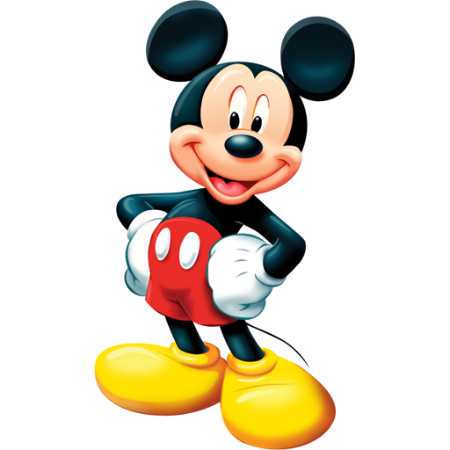

Slide 2
CONTENTS
Biography
Disney’s family
Childhood
World War I
Beginnings
Hollywood
Mickey Mouse
Walt’s private life
Disney in the post-war
Disneyland
Death
Family museum

Slide 3
WALTER ELIAS DISNEY
Walter Elias "Walt" Disney (December 5, 1901 – December 15, 1966) was an American film producer, director, screenwriter, voice actor, animator and entertainer. Disney is famous for his influence in the field of entertainment during the twentieth century. As the co-founder (with his brother Roy O. Disney) of
Walt Disney Productions, Disney became one of the best-known motion picture producers in the world.
Contents

Slide 4
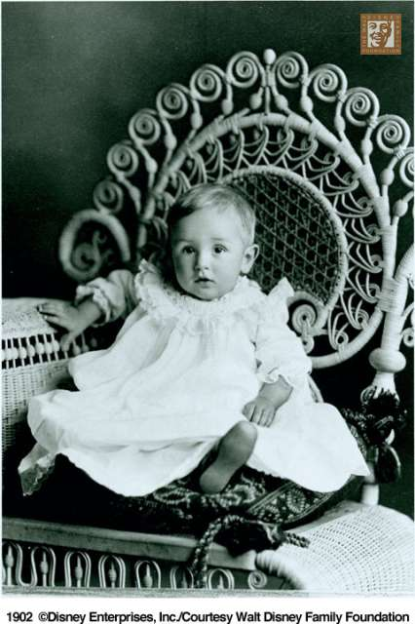
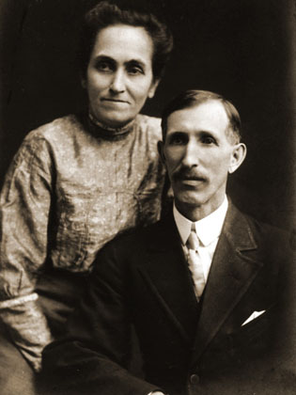
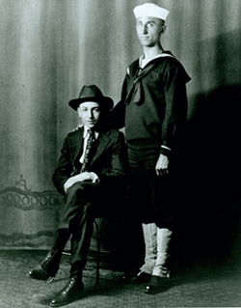
DISNEY’S FAMILY
Walter Elias Disney was born in Chicago Illinois, to his father, Elias Disney, an Irish-Canadian, and his mother, Flora Call Disney, who was of German-American descent. Walt was one of five children, four boys and a girl.

Slide 5
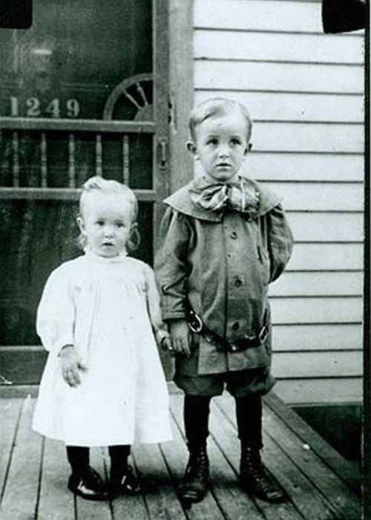
CHILDHOOD
After Walt's birth, the Disney family moved to Marceline, Missouri. Walt had a very early interest in drawing and Art. When he was seven years old, he sold small sketches, and drawings to nearby neighbours. One of their neighbours, a retired doctor named "Doc" Sherwood, paid him to draw pictures of Sherwood's horse, Rupert.

Slide 6
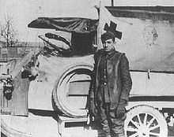
WORLD WAR I (1914-1918)
.
Disney was an ambulance driver during World War I.

Slide 7
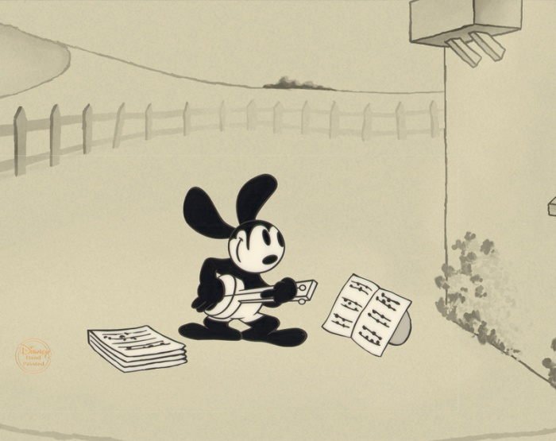
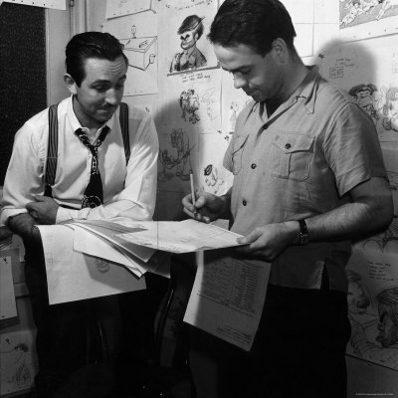
LAUGH O'GRAM STUDIO
In 1920 Walt took up an interest in the field of animation, and decided to become an animator. Before reading some books, he decided to open his own animation business and recruited a fellow co-worker at the Kansas City Film Ad Company, Fred Harman, as his first employee. They titled their company "Laugh-O-Grams". Walt had started to create The Alice Comedies, which was about a real girl and her adventures in an animated world, Walt ran out of money, and his company “Laugh-O-Grams” went bankrupted.

Slide 8
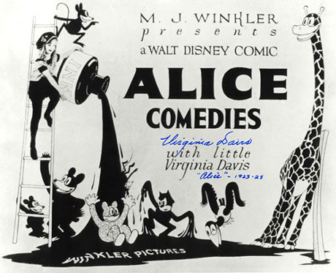
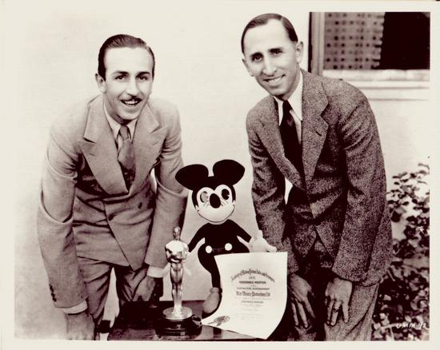
HOLLYWOOD
The early flop of The Alice Comedies inoculated Walt against fear of failure; he had risked it all three or four times in his life. Walt's brother, Roy O. Disney, was already in California, with an immense amount of sympathy and encouragement, and $250. Pooling their resources, they borrowed an additional $500, and set up shop in their uncle's garage. Soon, they received an order from New York for the first Alice in Cartoon land (The Alice Comedies) features, and the brothers expanded their production operation to the rear of a Hollywood real estate office. It was Walt's enthusiasm and faith in himself, and others, that took him straight to the top of Hollywood society.

Slide 9
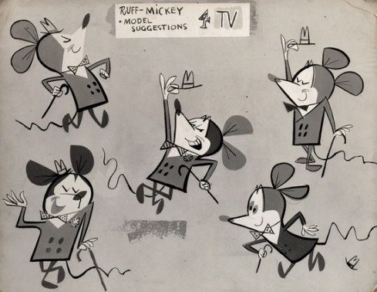
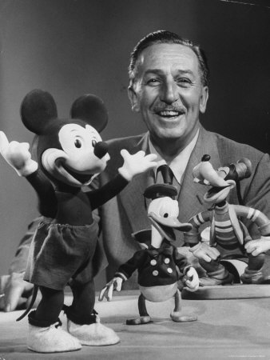
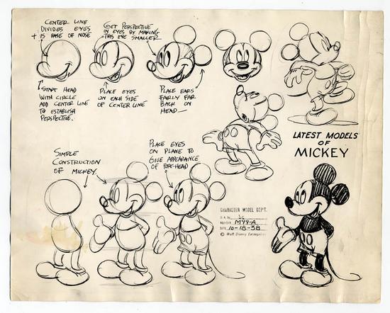
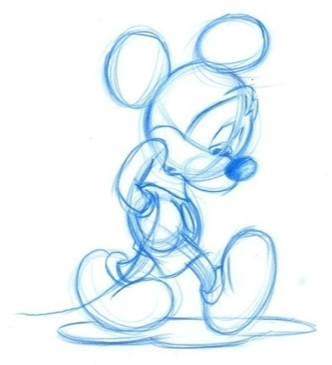
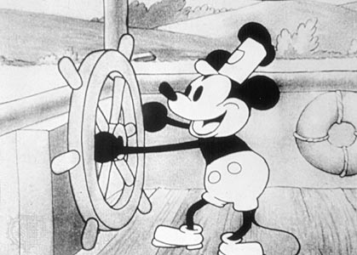
MICKEY MOUSE
In 1928 Walt created a new animated character, Mickey Mouse.
His talents were first used in a silent cartoon entitled Plane Crazy. However, before the cartoon could be released, sound was introduced upon the motion picture industry. Thus, Mickey Mouse made his screen debut in Steamboat Willie, the world's first synchronized sound cartoon, which premiered at the Colony Theater in New York on November 18, 1928.

Slide 10
IT IS THE FIRST DISNEY’S DRAWING OF MICKEY MOUSE

Slide 11
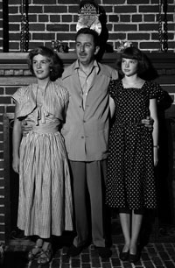
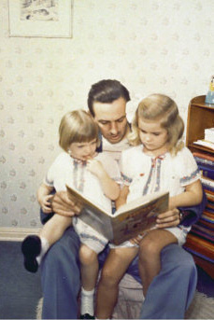
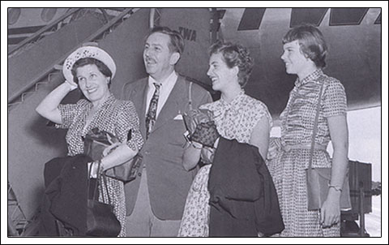
WALT’S PRIVATE LIFE
On July 13, 1925, Walt married one of his first employees, Lillian Bounds, in Lewiston, Idaho. They had two daughters, Diane Marie Disney (December 18, 1933) and Sharon Marie Disney (December 31, 1936 ).

Slide 12
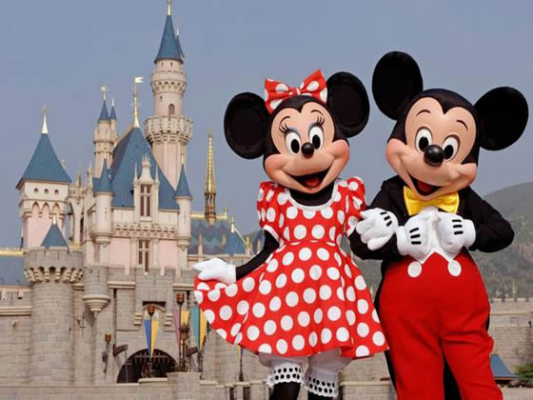
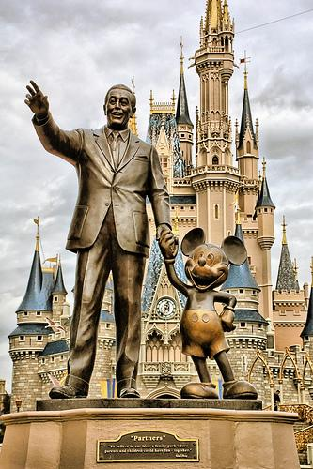
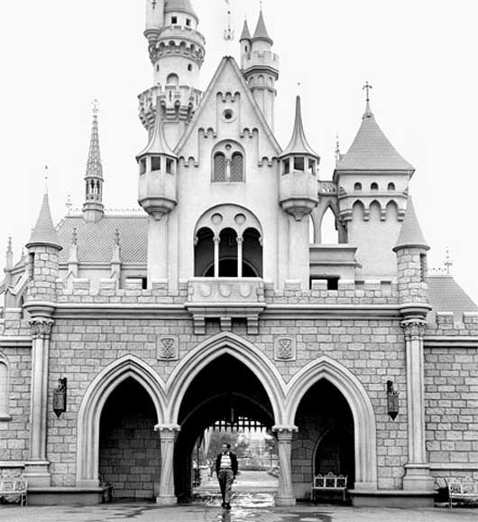
DISNEY’S DREAM
Walt Disney's dream of a clean, and organized amusement park, came true, as Disneyland Park opened in 1955.

Slide 13
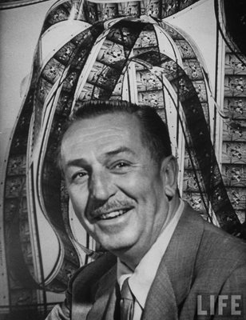
WALT DISNEY’S DEATH
Disney died in December, 15, 1966
at 9:30 a.m., ten days after his 65th birthday.

Slide 14
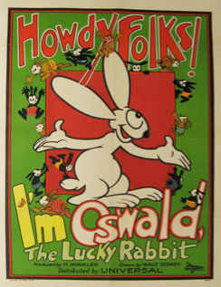
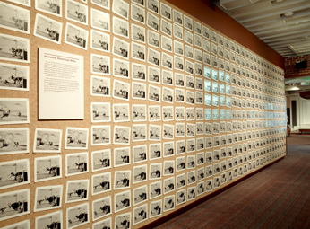
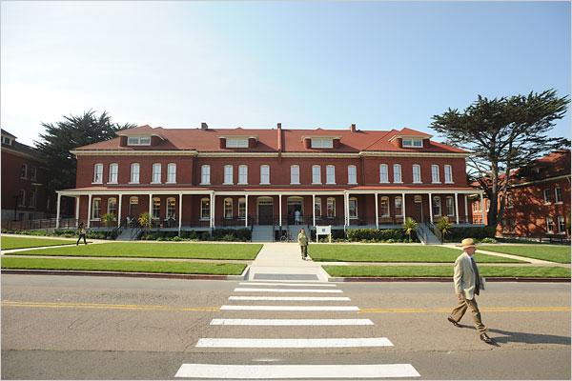
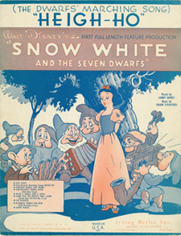
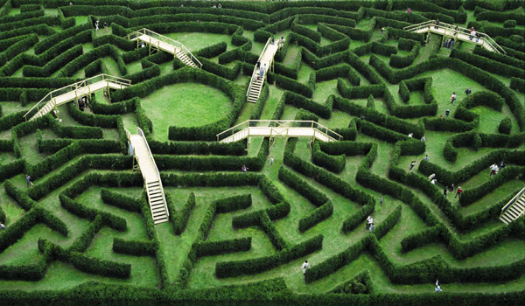
THE WALT DISNEY FAMILY’S MUSEUM
The Walt Disney Family Museum was conceived to present the real story of Walt Disney, the man, told by him and others who knew him well.

Slide 15
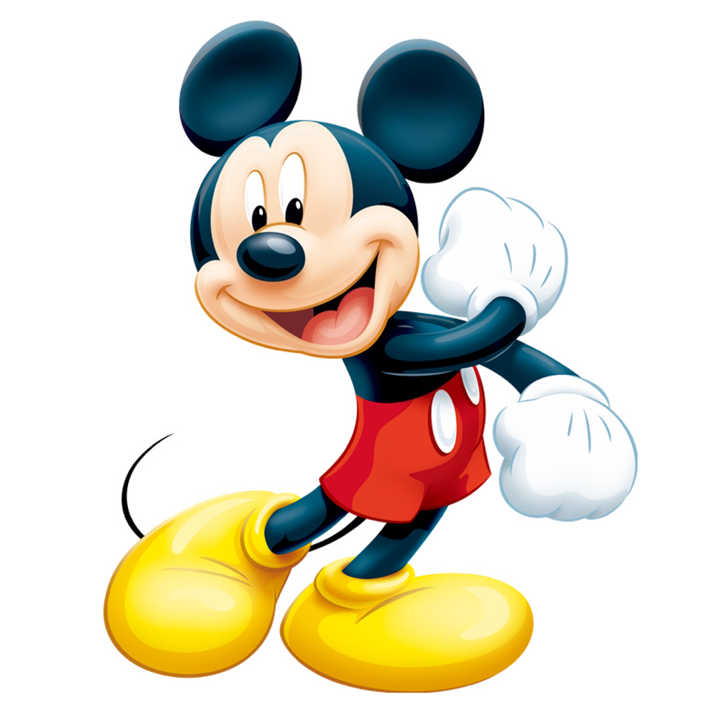
THE END
THANK YOU FOR YOUR ATTENTION!

